Slide 1
Evaluation of Microservice Architecture Designs in an IoT-Context
Abramov Sviatoslav svyatabram@gmail.com
Supervisor: Prof. Dr.-Ing Günter Schäfer
Supervisor: Associate Prof. Dr. Igor Anikin

Slide 2
Content
Introduction
Requirements
State of the Art
The system overview
Results
Conclusion
Future Work

Slide 3
Introduction

Slide 4
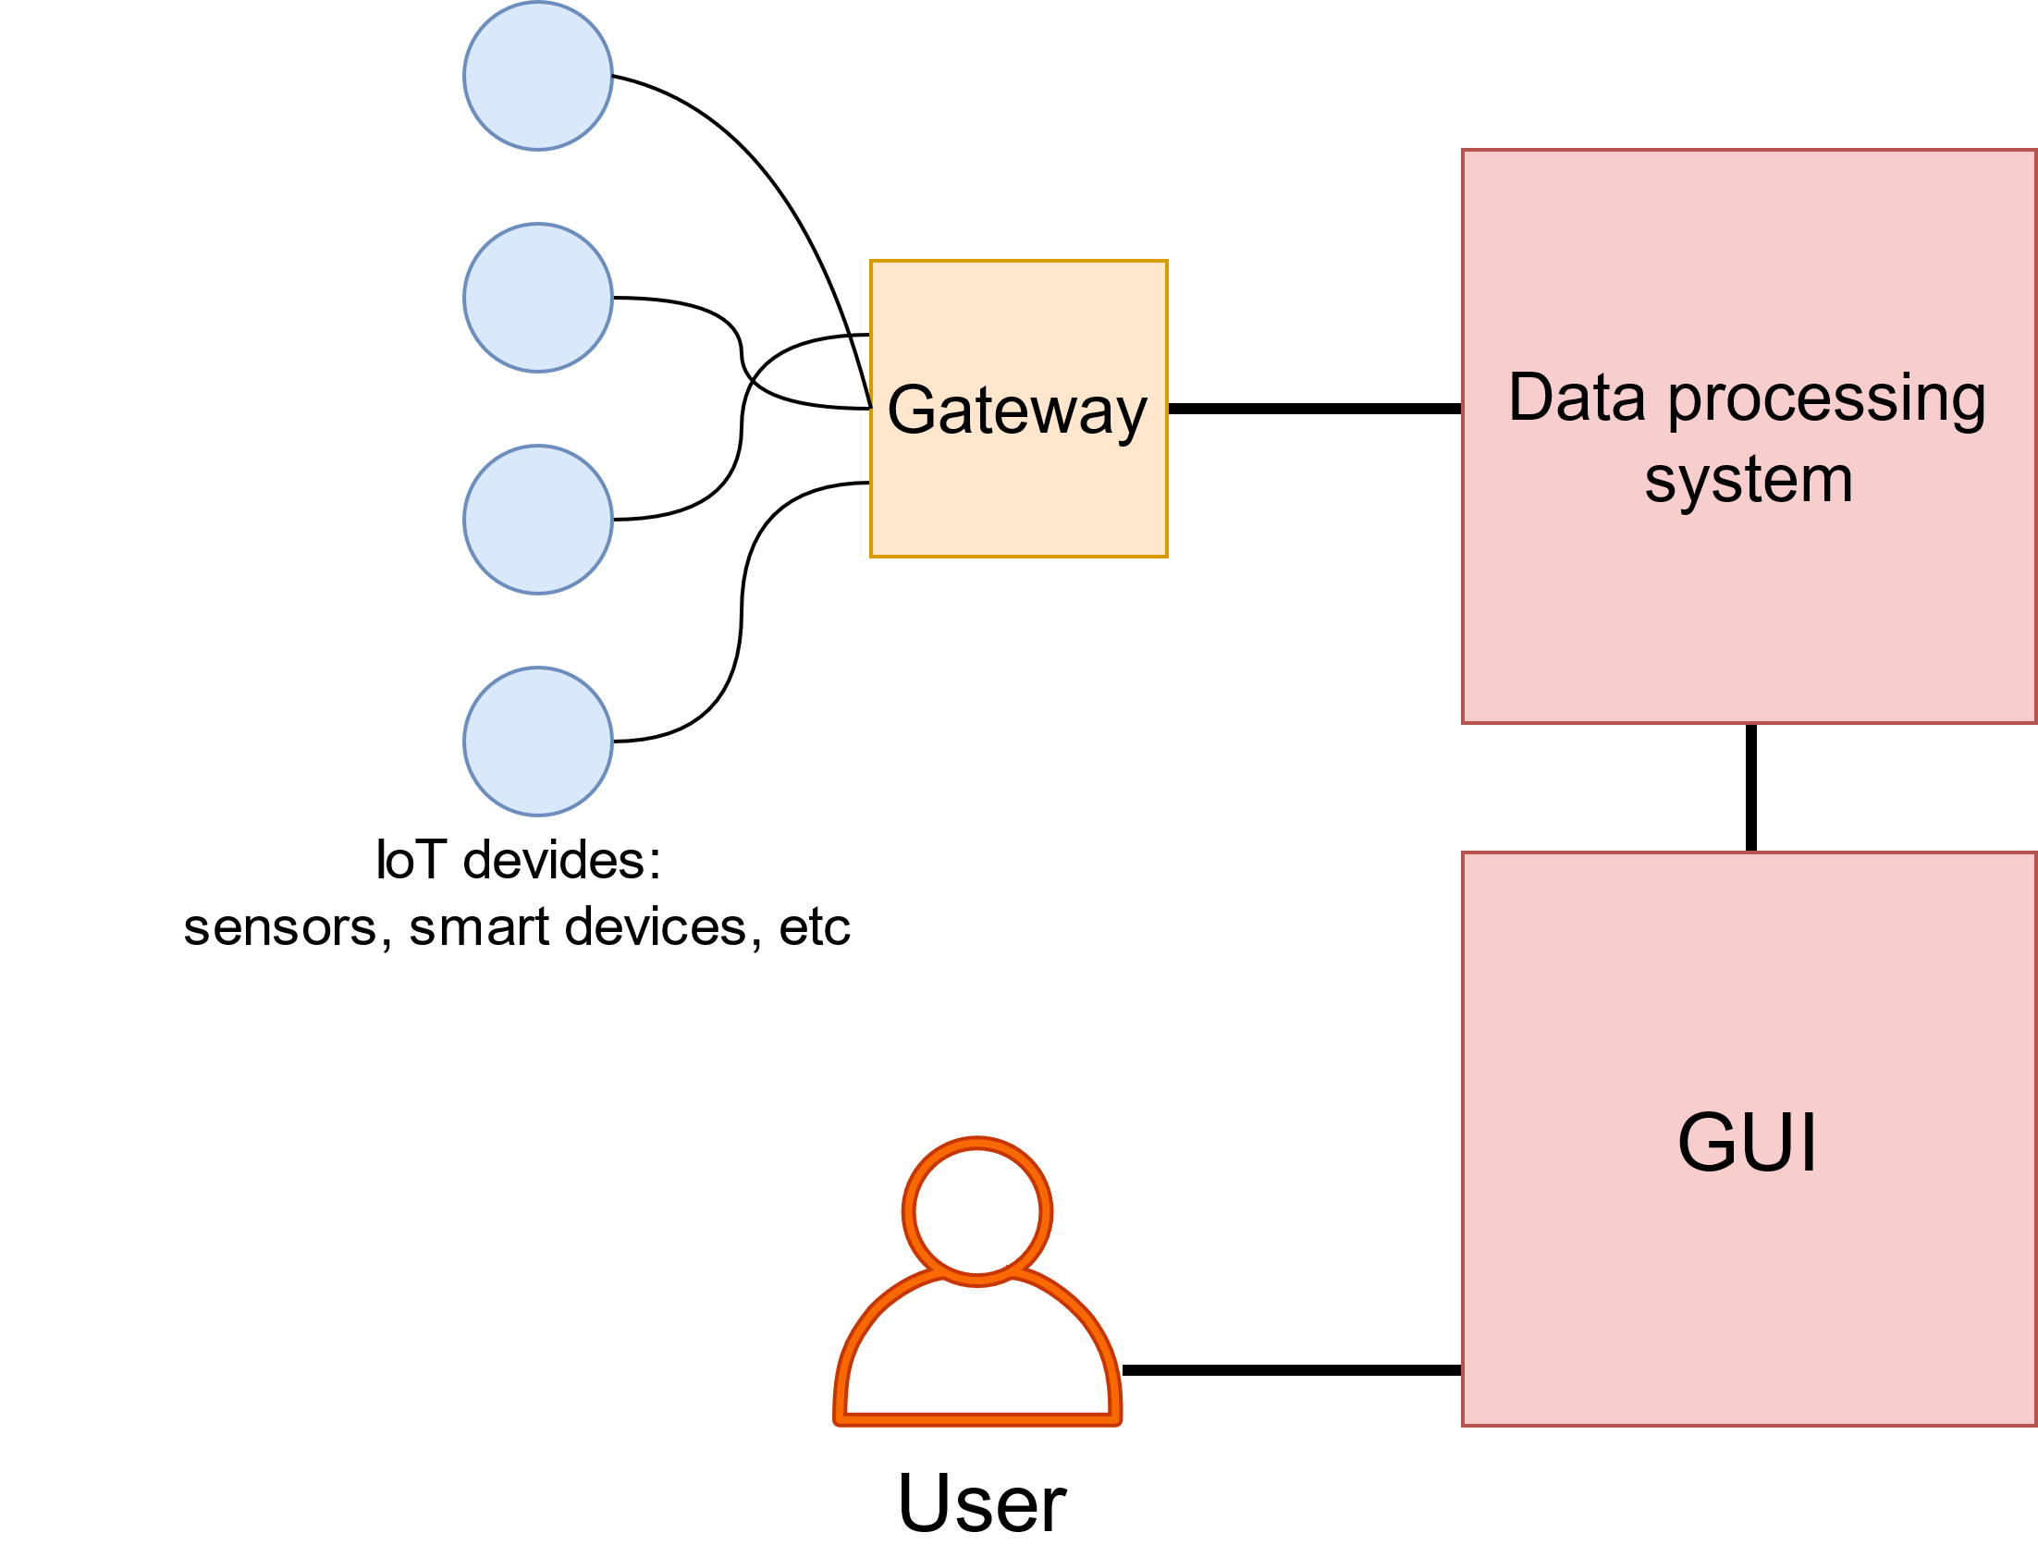
The Internet of Things
IoT architecture elements:
Gateway collects and transports IoT devices data.
DPS processes received data.
GUI represents processed data to end users.
IoT architecture diagram.

Slide 5
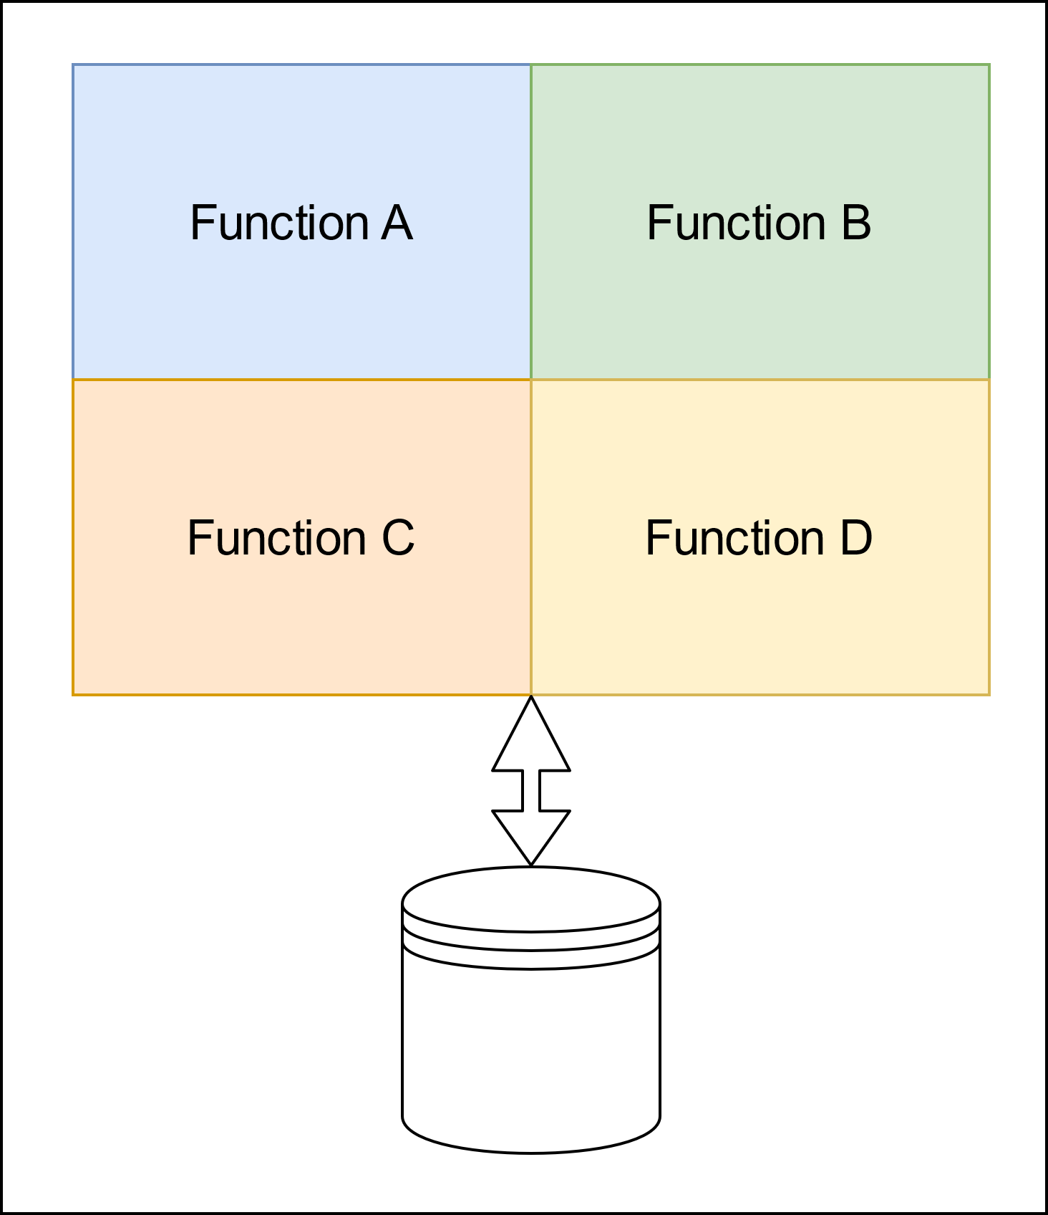
Microservices architecture
Drawbacks:
Can not be horizontally scaled
Modules share the same memory space
A module bugs affect the whole application
Continuous deployment is almost impossible
Suitable for lightweight and not multifunctional applications.
Monolithic architecture example.

Slide 6
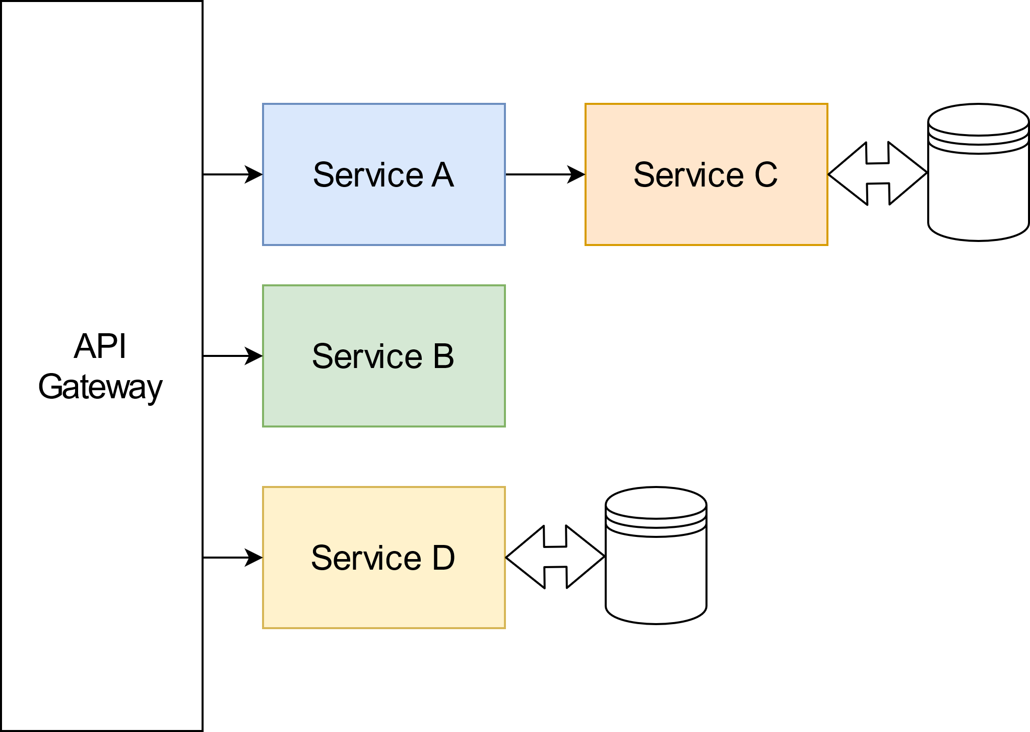
Microservices architecture
Microservices architecture example.

Slide 7
Microservices architecture
Advantages:
Functional decomposition
Each service can be scaled independently
Services do not share the same memory space
Each service is developed independently
Drawbacks:
Complex deploying and testing
Difficult interconnection process
Microservices architecture example.

Slide 8
Microservices architecture
Advantages:
Functional decomposition
Each service can be scaled independently
Services do not share the same memory space
Each service is developed independently
Drawbacks:
Complex deploying and testing
Difficult interconnection process
Microservices architecture example.
Suitable for high-loaded and multifunctional application such as IoT data processing system

Slide 9
The goals
The main goal is to find the best MSA architecture design in an IoT context.

Slide 10
The goals
The main goal is to find the best MSA architecture design in an IoT context.
We compared:
Interconnection methods
Database management systems
Load balancing strategies

Slide 11
What we have done
Analyzed the most demanded technologies in MSA context.
Built the MSA application, satisfying the most common requirements.
Developed a load generation, simulating IoT devices.
Implemented a monitoring system
Processed measurements.

Slide 12
Requirements

Slide 13
Functional requirements
Provide connectivity for IoT devices.
Transform IoT device data model to the system data model.

Slide 14
Non-functional Requirements
Qualitative
Testable
Reproducible
Deployable

Slide 15
Non-functional Requirements
Qualitative
Quantitative
Testable
Reproducible
Deployable
Response time
Scalable

Slide 16
State of the art

Slide 17
Basic articles
M. S. Hatem Hamad and R. Abed, “Performance evaluation of restful web services for mobile devices,” Computer Engineering Department, Islamic University of Gaza, Palestine, International Arab Journal of e-Technology, 2010.
In the article advantages of RESTful web services before SOAP web services are shown:
RESTful web services provide less message size.
RESTful web services provide less response time.

Slide 18
Basic articles
P. J. Amaral M. and C. D., “Performance evaluation of microservices architectures using containers.,” IEEE 14th International Symposium on Network Computing and Applications, 2015.
This article shows Server Virtualization provides performance improvement
SV increases server throughput
SV decreases server latency

Slide 19
Basic articles
J. F. Kunhua Zhu and Y. Li, Research the performance testing and performance improvement strategy in web application”, 2nd international Conference on Education Technology and Computer. 2010.
This article provides a survey about overall MSA based application testing :

Slide 20
Basic articles
J. F. Kunhua Zhu and Y. Li, Research the performance testing and performance improvement strategy in web application”, 2nd international Conference on Education Technology and Computer. 2010.
This article provides a survey about overall MSA based application testing :
Functional and load testing of web MSA based web applications basis.
Prediction of an application response time changing with an increasing user load.
User load impact on application throughput.
Possible bottlenecks caused by system utilization.

Slide 21
Not answered questions
Which design chooses we have to made to build MSA system in an IoT-device context?
Which interconnection method fits a certain service functionality better?
How to use load balancing according to services functionality?

Slide 22
The system overview

Slide 23
The system developing
The MS system has to provide connectivity, session management, and data model transformation.
Response time is assessment criteria.
The server virtualization and imaging
Load generator is able to generate different load

Slide 24
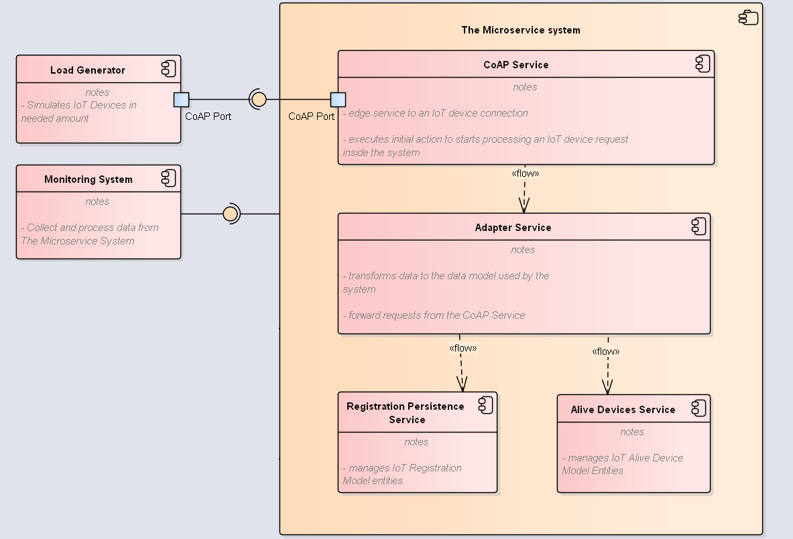
The system developing
The system components diagram.

Slide 25
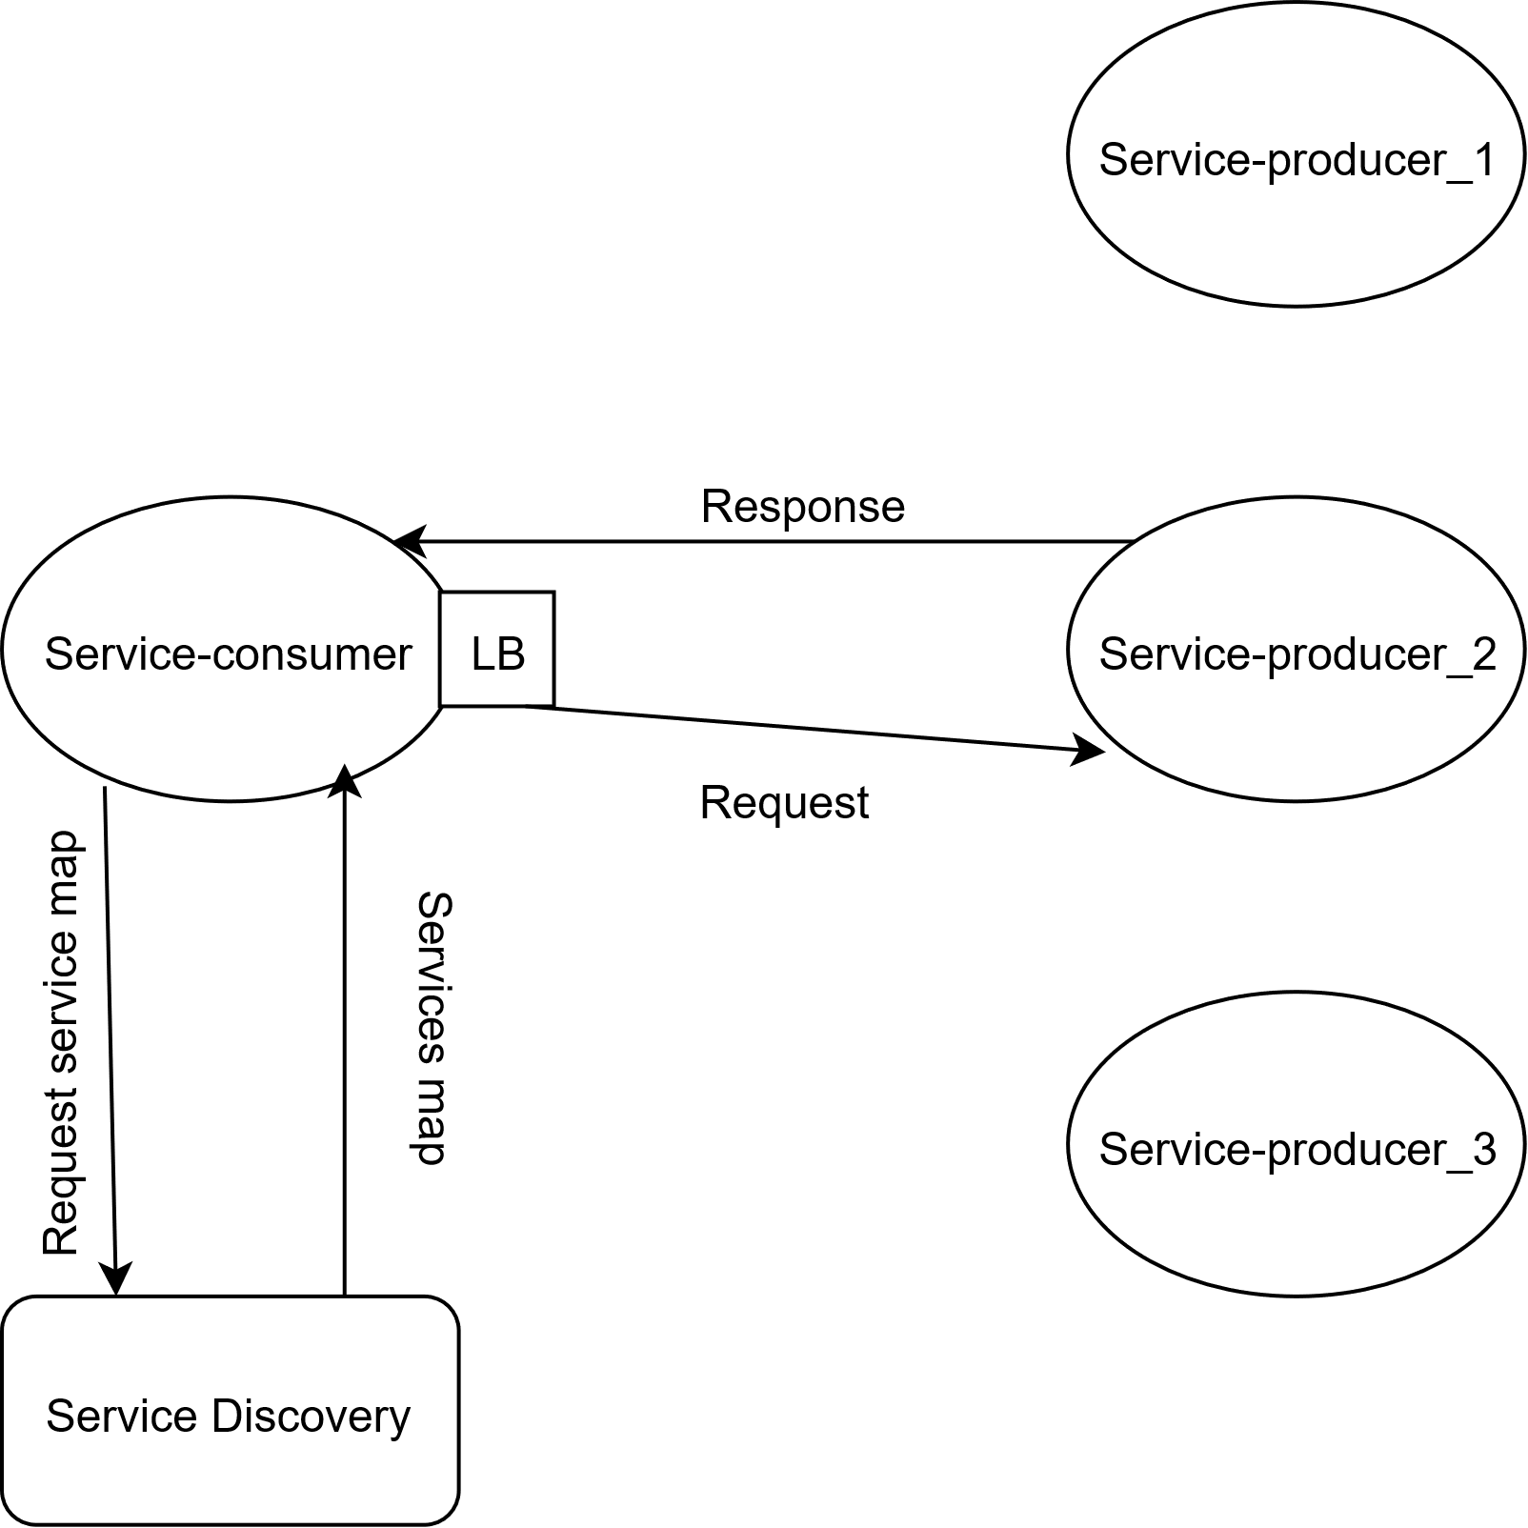
Client-side LB
Each service knows about other service instances.
Every service instance has to connect to service discovery.
Client-side LB diagram.

Slide 26
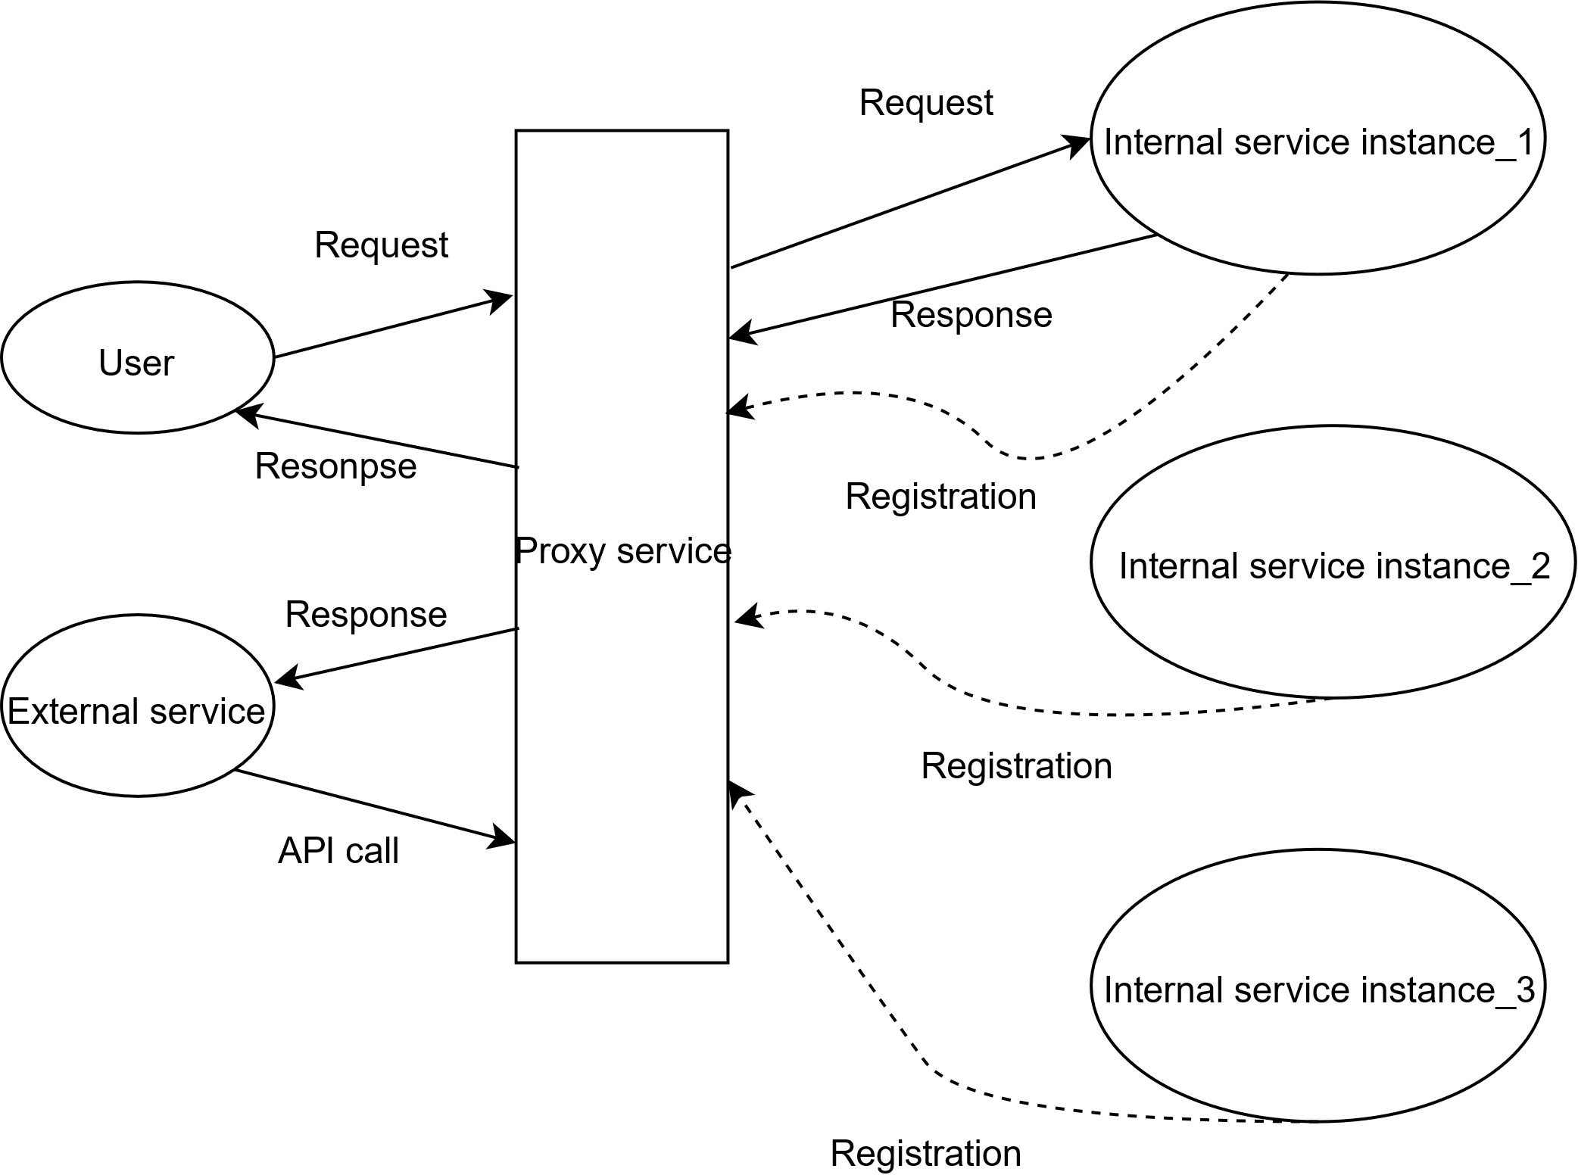
Server-side LB
Each service instance knows only URI of requesting service
Every service instance has to connect to proxy/gateway service.
Server-side LB diagram.

Slide 27
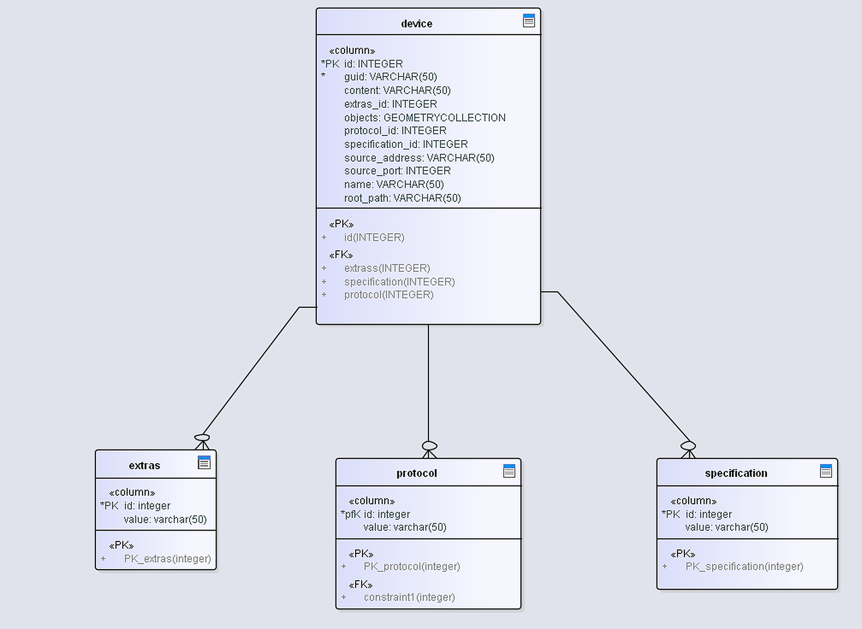
Registration data model
Simple session management
Contains a device description

Slide 28
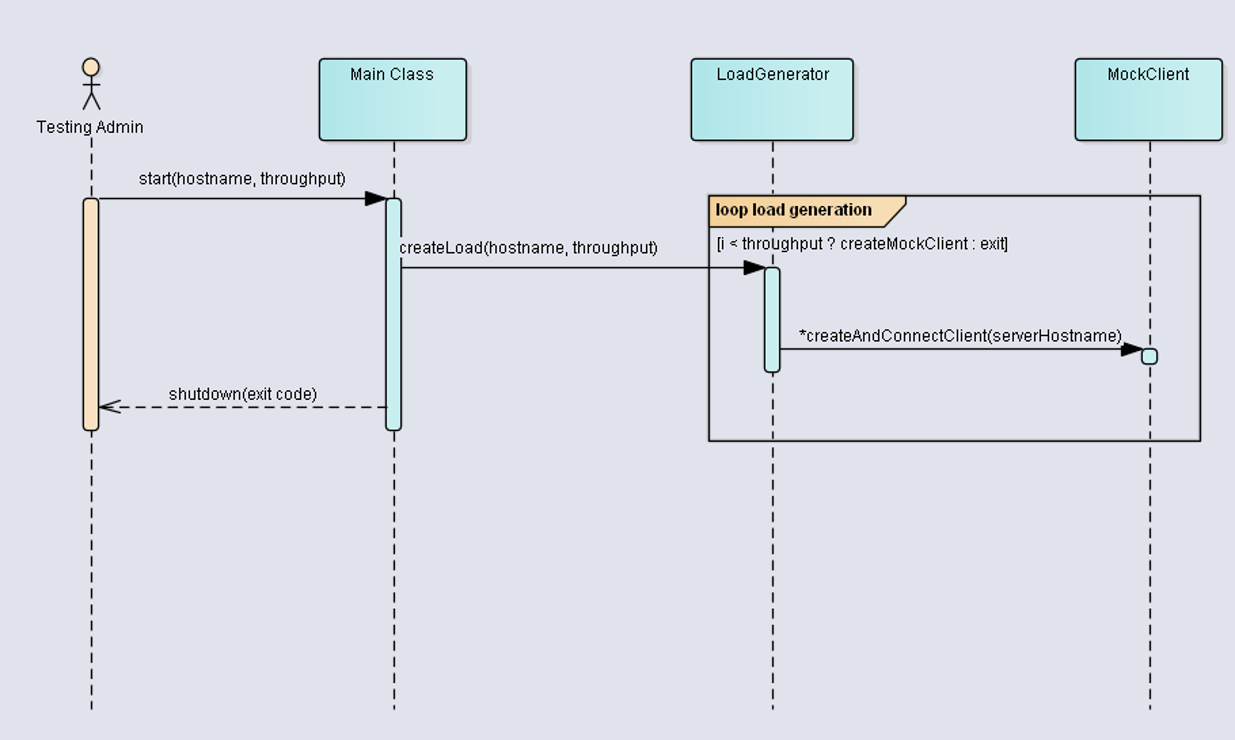
Load generation
Simulates a given amount of IoT devices.
Load generation sequence diagram.

Slide 29
Measuring system
To measure response time we used distributed tracing system.
We stored trace logs in document-oriented DB.
We used search engine to retrieve and analyze logs

Slide 30
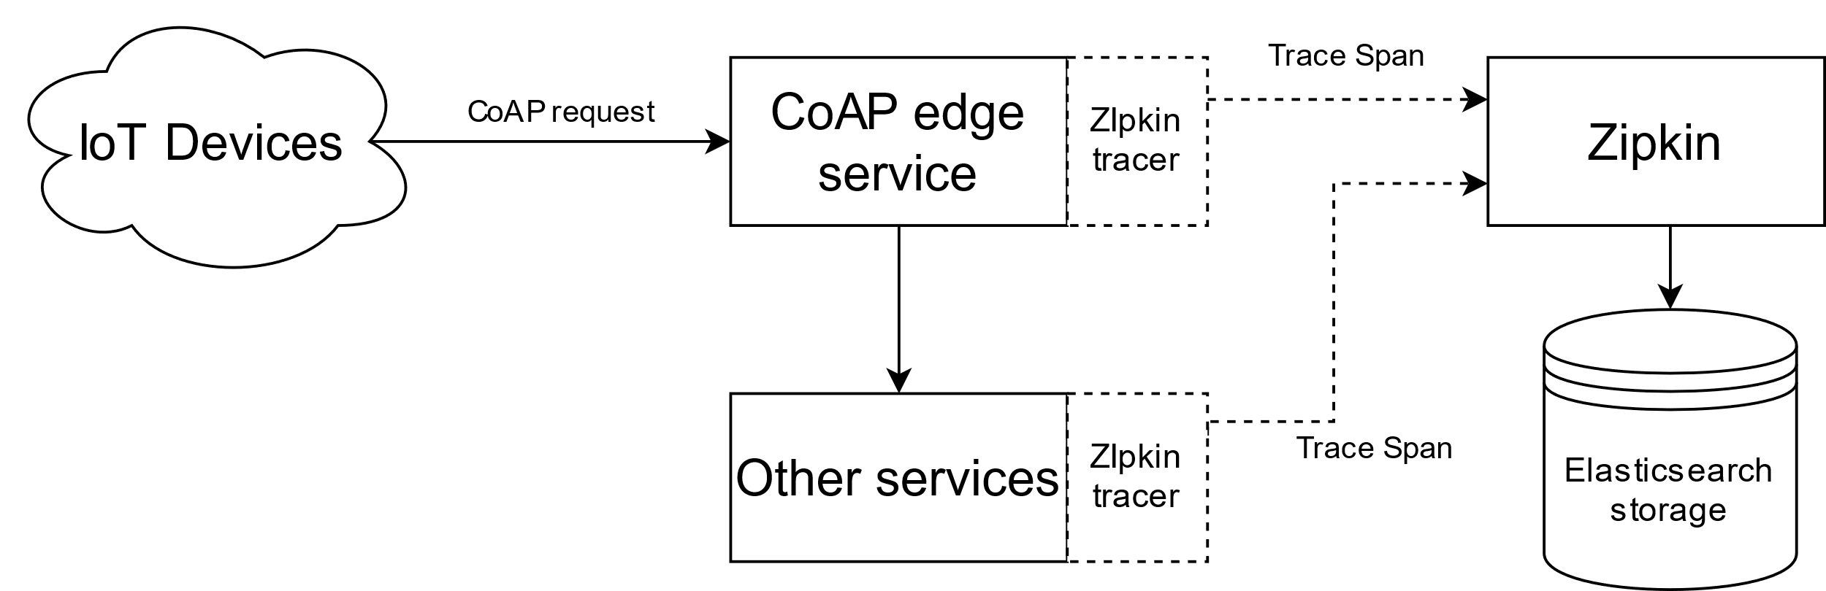
Measuring system
Measuring system diagram.
Each service uses Zipkin API to send tracing spans to Zipkin server.
All spans persist in ES database.
Possibility to measure each service response time.
Services traceroute.

Slide 31
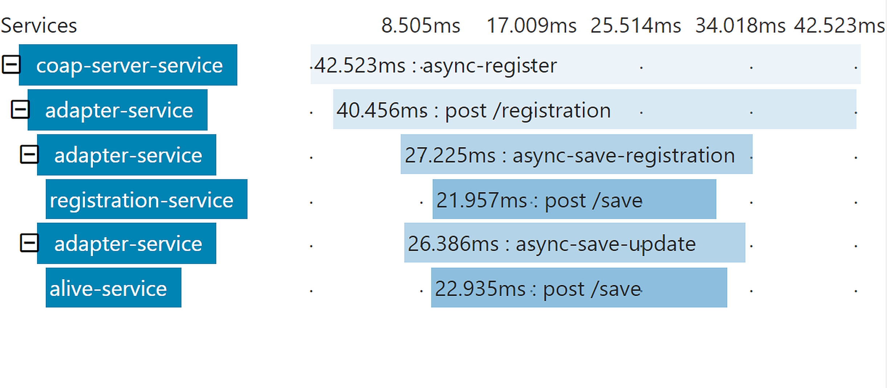
Measuring system
Request timeline diagram example.

Slide 32
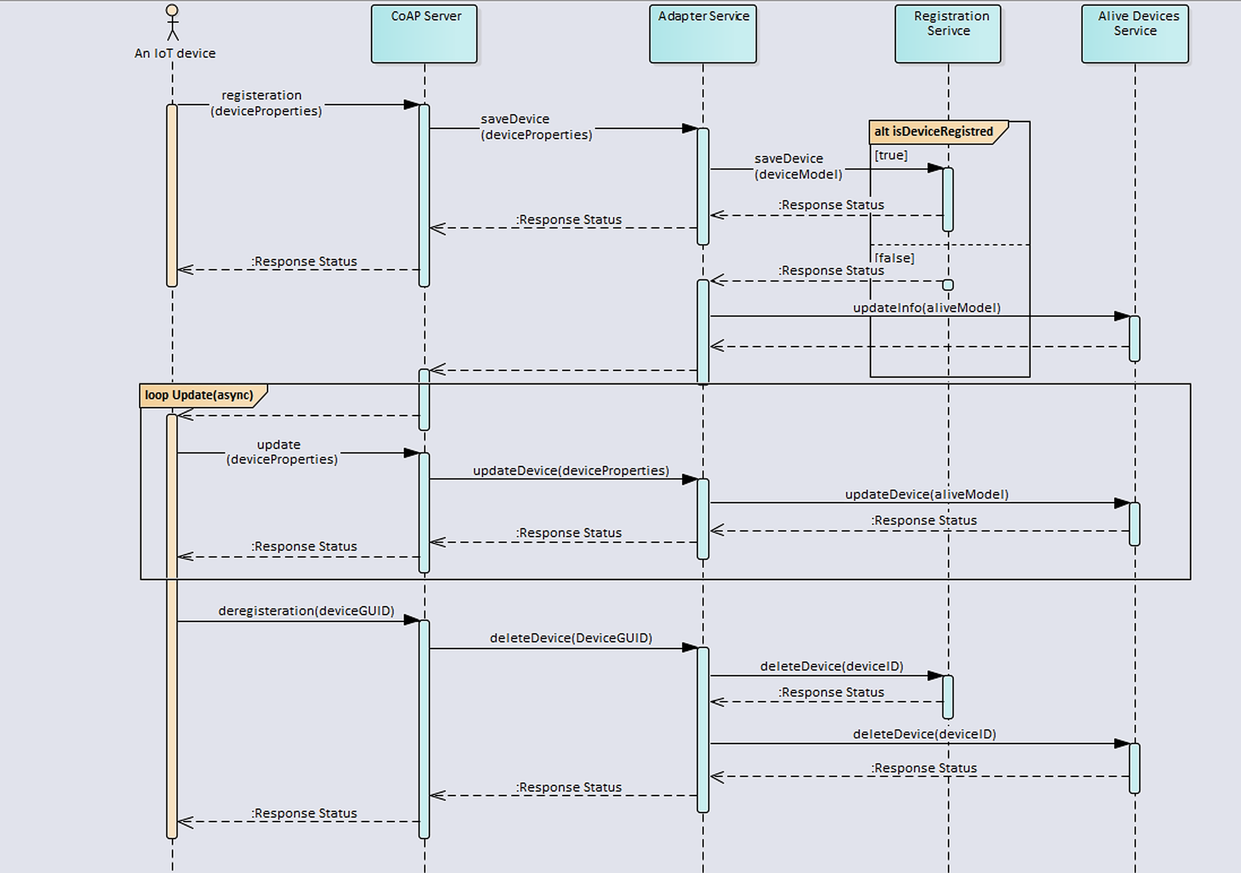
Test scenario
Test sequence diagram.

Slide 33
Results

Slide 34
Interconnection comparison
RabbitMQ provides the lowest response time of less than 1 millisecond.
Async. HTTP provides the highest response time, a bit higher 70 milliseconds.

Slide 35
Transaction duration by service
gRPC interconnection provides lowest transaction duration time of persistence services.
RabbitMQ provides the lowest transaction duration time of non-persistence services.

Slide 36
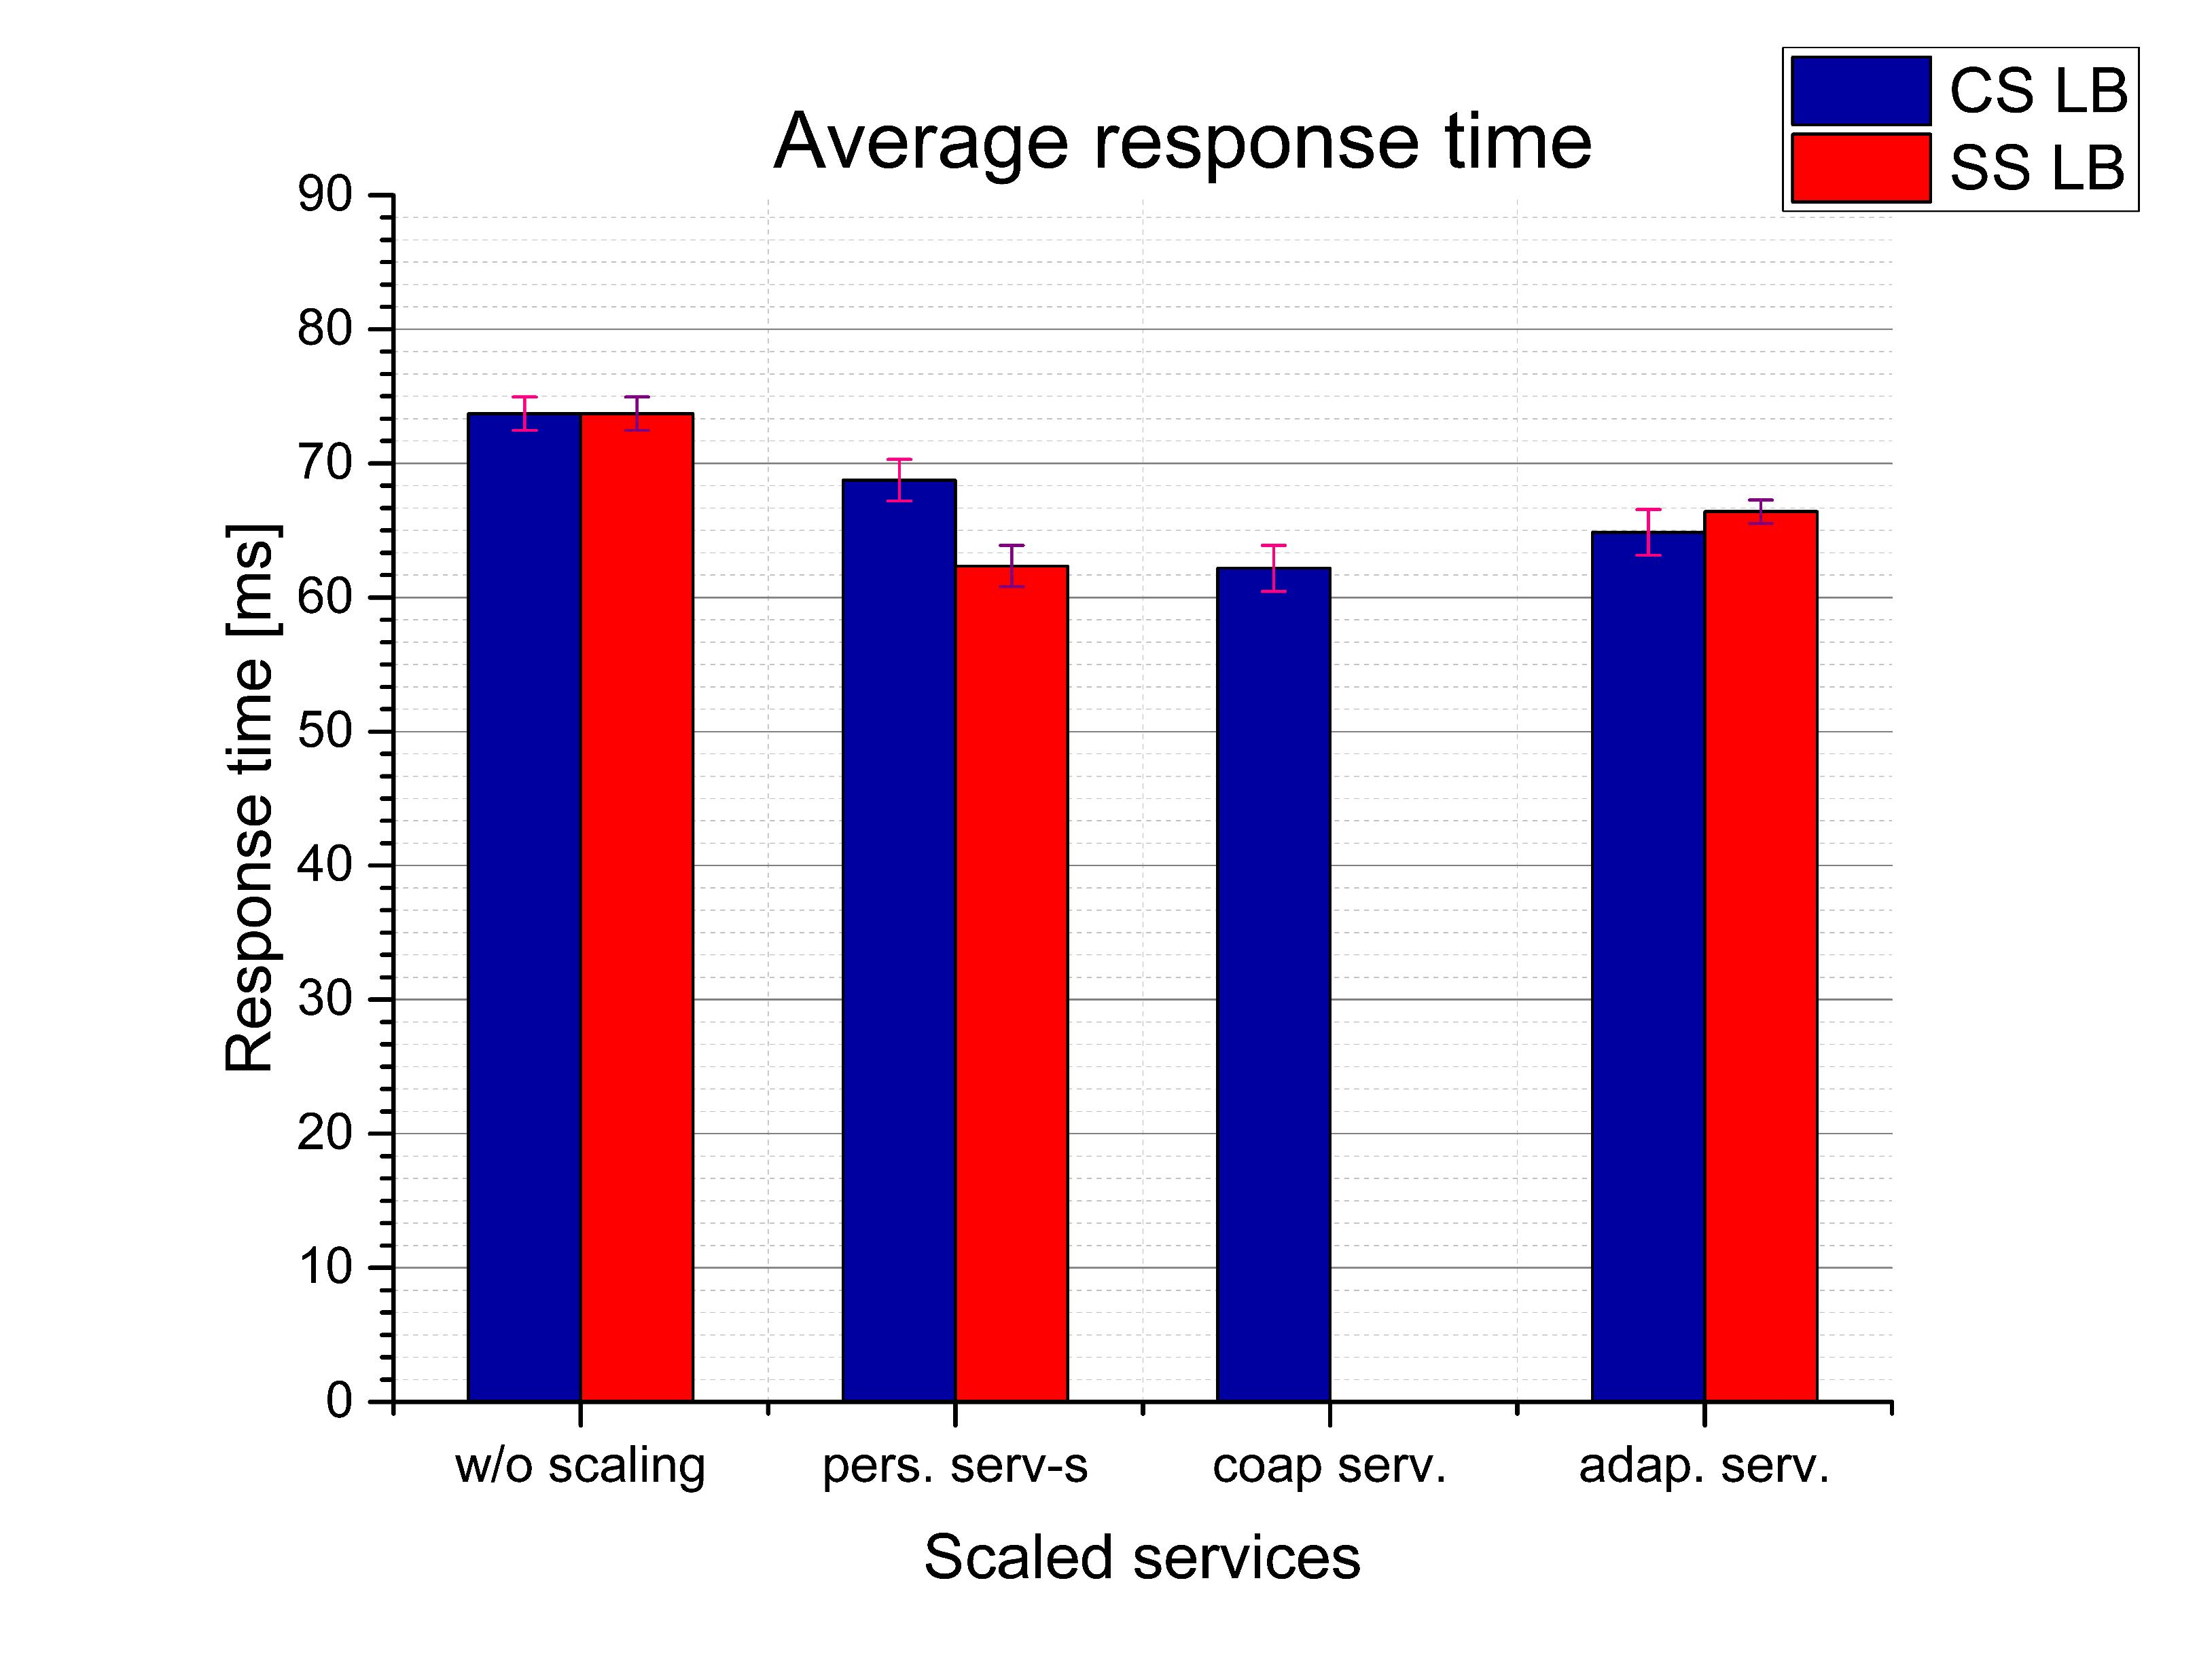
Load balancing strategies comparison
Client-side LB strategy provides about 10% less a system response time, scaling persistency services.
Server-side LB strategy improves the system response by almost the same amount but by scaling edge service.

Slide 37
LB Impact on services
Server-side LB provides slightly faster overall response time.

Slide 38
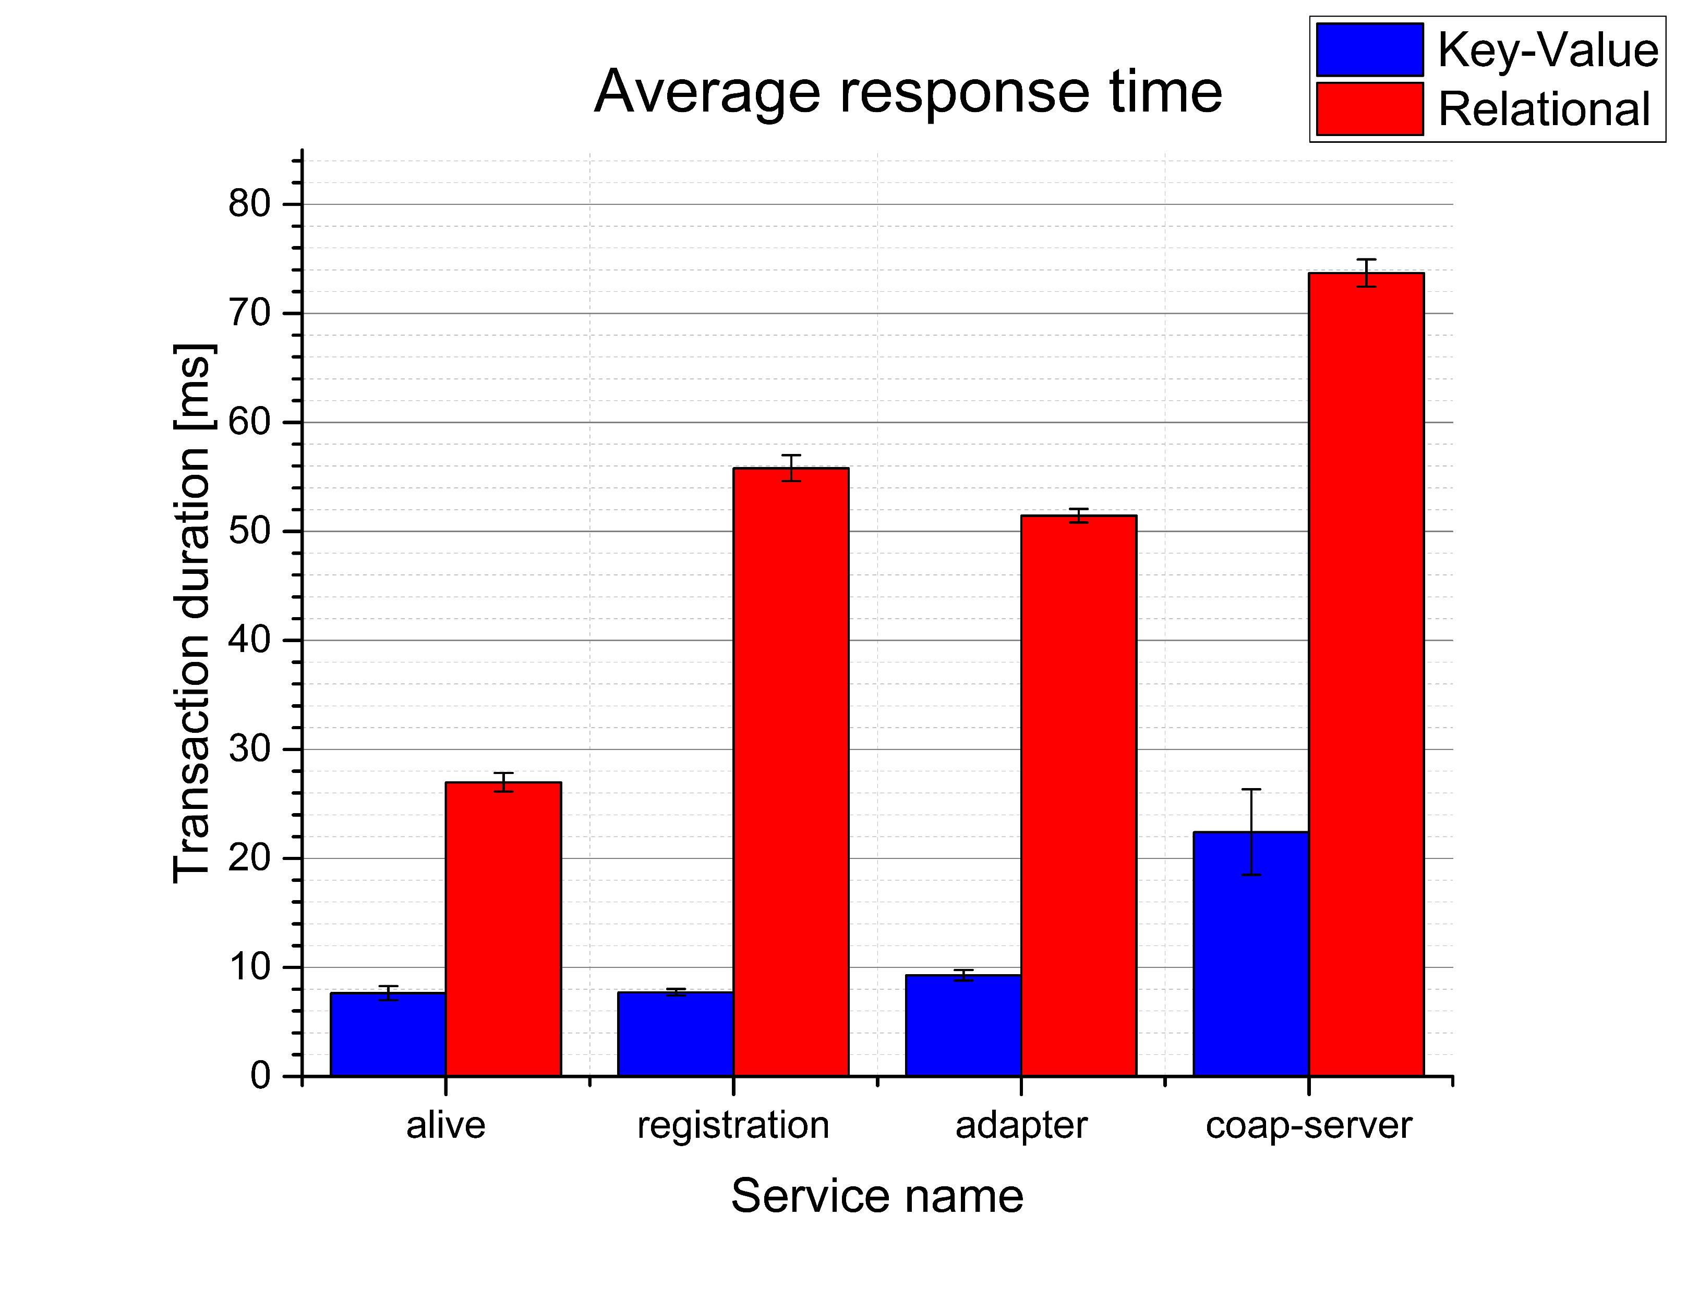
DBMS comparison
Key-Value DBMS requires significantly less time to execute database operations.
To process a DB operation, it needs 8 milliseconds, approximately.

Slide 39
Conclusion

Slide 40
Conclusion
Connect non-persistence services via RabbitMQ and persistence services via gRPC.
Document-oriented DBMS can ensure the lowest transaction duration of persistence services.
Load balancing strategy choice depends on which service has to be scaled. Also, server-side one provides a little faster response time.

Slide 41
Future work
To test the microservice system with some additional services satisfying more realistic requirements.
Improve the load generator.
Survey about how caching might affect the system response time.
Prove our research for production usage.

Slide 42
Thank you for your attention

